Slide 1
EnergAIze: Revolutionizing Energy Forecasting for a Sustainable Future
Student Name:
AYUSH NAGAR (1022813)
VISHAL CHAUHAN

Slide 2
Defining the Subject
Demand Forecasting is the important area for business and country alike. Energy demand is increasing due to increase in technological advancement. It is a need of time to tackle climate with machine learning. Therefore, for this project the dataset that is chosen from “ Entsoe ANDOpenweather”.
Dataset is taken from these website and it contains 35064 rows and 29 columns. The dataset have 4 years of electrical consumption,
generation, pricing and weather data for spain. The links are given in references. The dataset have hourly data for electrical consumption and respective forecast by Transmission Service Opersator (TSO) such as Spanish esios Red Electric Espana (REE) for consumption and pricing.

Slide 3
Business need and problem statement
The problem being considered for the project is to predict or forecast energy demand
accurately in Spain. The research questions considered for this project are:
1. Which regression technique will accurately forecast the daily energy consumption demand using hourly period ?
2.How to accurately forecast energy demand 24 hour in advance compared to TSO?
3. Usingclassification, determine what weather measurement and cities influence most the electric
demand, prices, and generation capacity?
The tools that will be used are Python jupyter, Tableau, R, Excel and others as needed.
The systematic data analysis process approach will be used for the project.
After dataselection, initial analysis will be carried out followed by the exploratory analysis (EDA). Then
experimental design and model building will be carried out. Finally performance evaluation will
be done together with recommendations and conclusion.

Slide 4
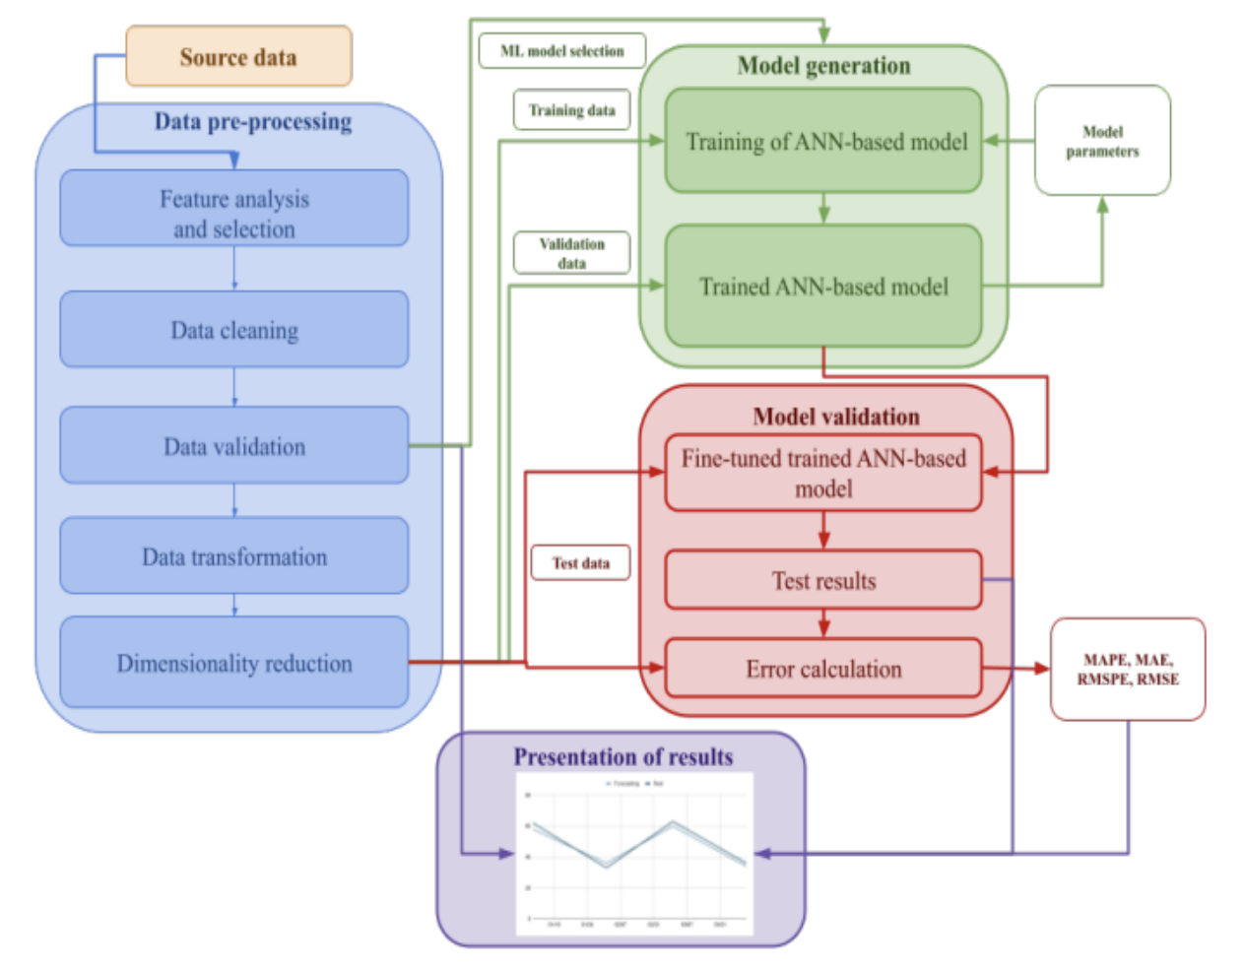
High-Level Architecture
;l
High level Architect found in review papers : Generalization of steps documented in review papers

Slide 5
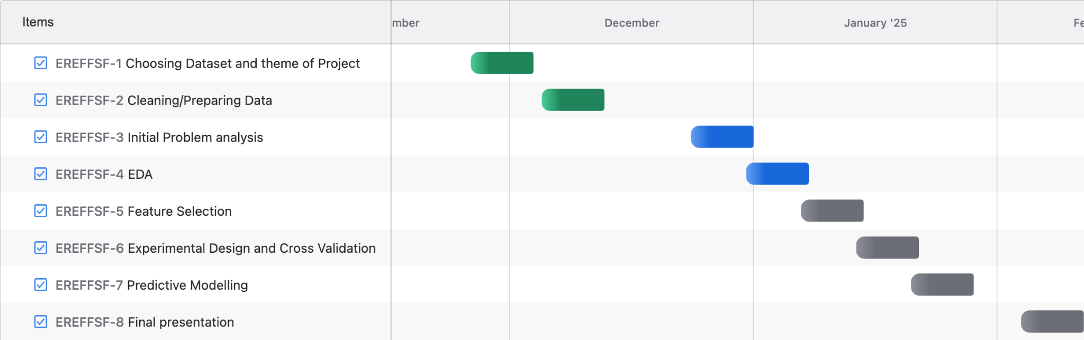
Gantt Chart

Slide 6
References:
Entsoe retrieved from https://transparency.entsoe.eu/dashboard/show
Openweather retrieved from https://openweathermap.org/api

